Slide 1
Lesson plan 09
Entropy and the Second Law of Thermodynamics
On the basis of direction, there are two types of thermodynamic processes:
Irreversible Process: An irreversible process is one that cannot be reversed by means of small changes in the environment.
Reversible Process: A reversible process is one that can be reversed to the original conditions from the final state without producing any changes in the thermodynamics properties of the environment.

Slide 2
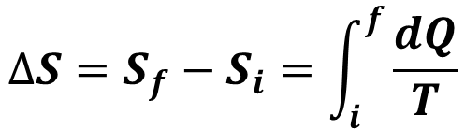
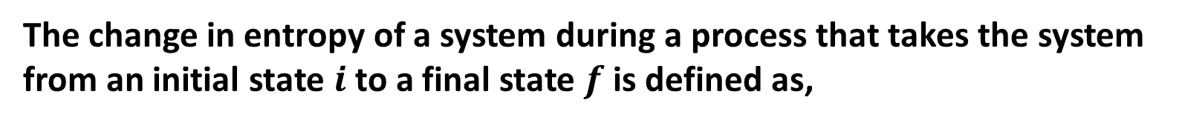
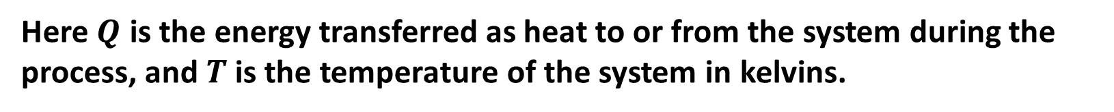
Change in Entropy
The change in entropy of a system during a process that takes the system from an initial state $i$to a final state $f$ is defined as,
$$∆S=S_{f}−S_{i}=\int_{i}^{f}{\frac{dQ}{T}}$$
Here $Q$ is the energy transferred as heat to or from the system during the process, and $T$ is the temperature of the system in kelvins.
Because $T$ is always positive, the sign of $∆S$ is the same as that of $Q$.
SI unit of entropy: J/K

Slide 3

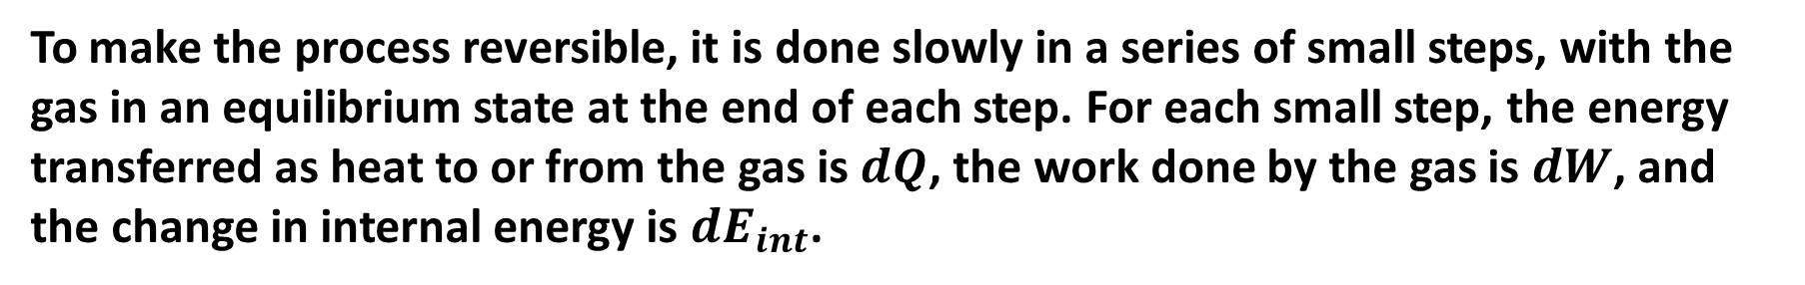

Entropy as a State Function
Consider, an ideal gas is taken through a reversible process.
To make the process reversible, it is done slowly in a series of small steps, with the gas in an equilibrium state at the end of each step. For each small step, the energy transferred as heat to or from the gas is $dQ$, the work done by the gas is $dW$, and the change in internal energy is $dE_{int}$.
From the first law of thermodynamics in differential form,
$$dQ= dW+dE_{int}……………(1)$$
We know for reversible process, $dW = p dV$
$$dE_{int}=nC_{v}dT$$

Slide 4
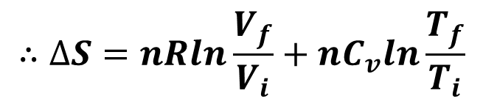


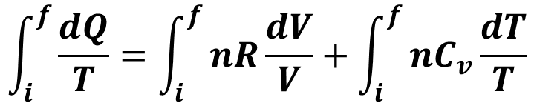
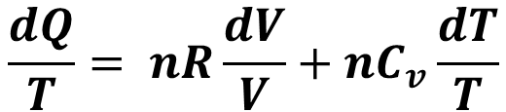
From equation (1),
$$dQ=p dV+nC_{v}dT$$
Using the ideal gas law, $p=\frac{nRT}{V}$ and dividing each term by T, we get
$$\frac{dQ}{T}= nR\frac{dV}{V}+nC_{v}\frac{dT}{T}$$
Integrating each term between an arbitrary initial state $i$ and an arbitrary final state $f$,
$$\int_{i}^{f}{\frac{dQ}{T}}=\int_{i}^{f}{nR\frac{dV}{V}}+\int_{i}^{f}{nC_{v}\frac{dT}{T}}$$
$$⇒∆S=nR{[lnV]}_{i}^{f}+nC_{v}{[lnT]}_{i}^{f}$$
$$∴∆S=nRln\frac{V_{f}}{V_{i}}+nC_{v}ln\frac{T_{f}}{T_{i}}$$

Slide 5
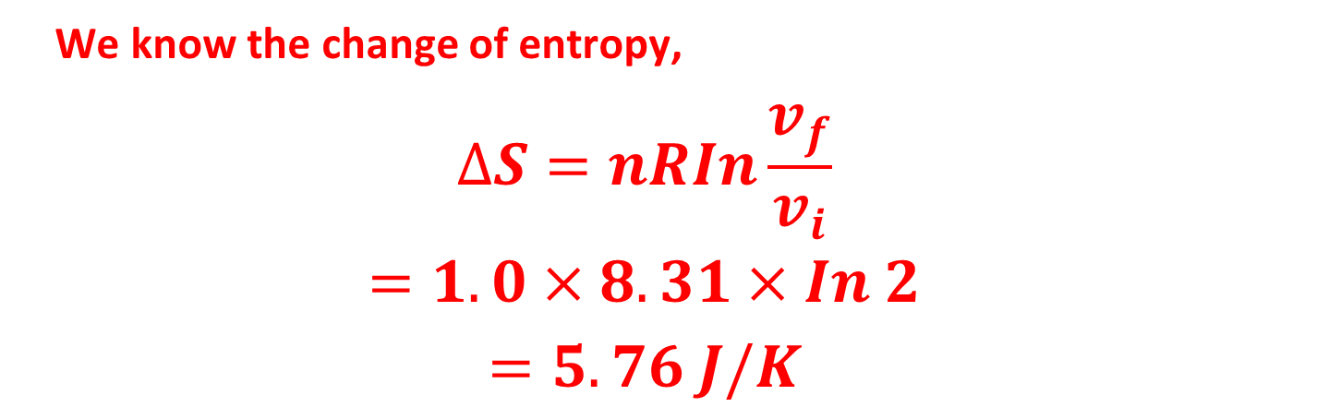
Sample Problem 20.02: Suppose 1.0 mol of nitrogen gas is confined to the left side of the container of Fig. 20-1a. You open the stopcock, and the volume of the gas doubles. What is the entropy change of the gas for this irreversible process?
We know the change of entropy,
$$∆S=nRIn\frac{v_{f}}{v_{i}}$$
$$=1.0×8.31×In 2$$
$$=5.76 J/K$$

Slide 6
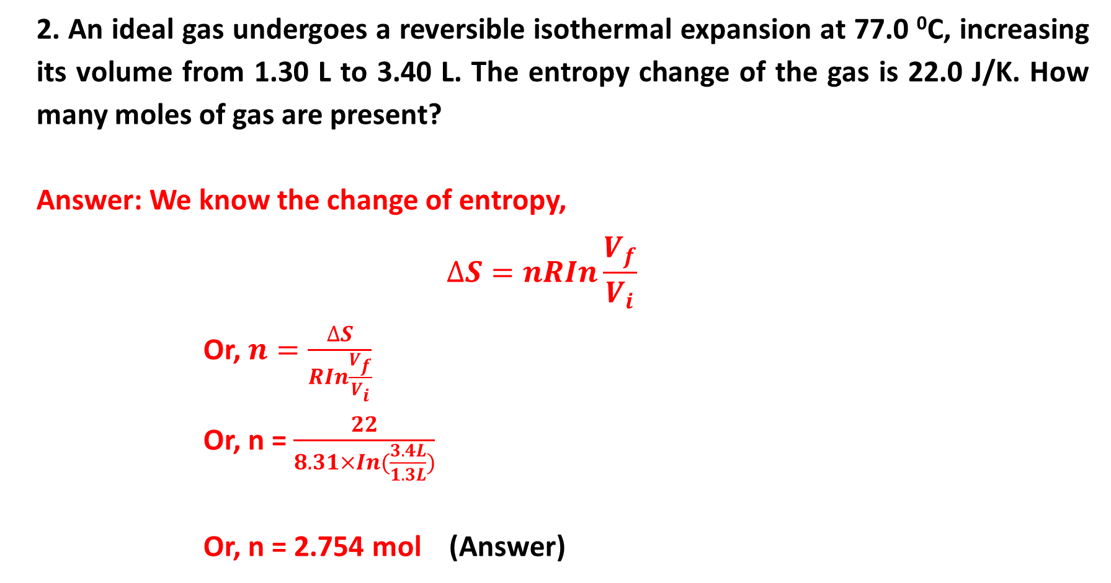
2. An ideal gas undergoes a reversible isothermal expansion at 77.0 ⁰C, increasing its volume from 1.30 L to 3.40 L. The entropy change of the gas is 22.0 J/K. How many moles of gas are present?
Answer: We know the change of entropy,
$$∆S=nRIn\frac{V_{f}}{V_{i}}$$
Or, $n=\frac{∆S}{RIn\frac{V_{f}}{V_{i}}}$
Or, n = $\frac{22}{8.31×In(\frac{3.4L}{1.3L})}$
Or, n = 2.754 mol (Answer)

